Slide 1
CONTROL SYSTEM
AND ITS APPLICATIONS
SYED HASAN SAEED
Declaration : The content of the presentation has been created for academic use / non-commercial use with fair dealing.

Slide 2
AUTOMATIC CONTROL SYSTEMS
BOOKS
CONTROL SYSTEM B.C. KUO
CONTROL SYSTEMS K. OGATTA
CONTROL SYSTEMS NAGRATH & KOTHARI
AUTOMATIC CONTROL SYSTEMS S.HASAN SAEED
AUTOMATIC CONTROL SYSTEMS R. A. BARAPATE
CONTROL SYSTEM A. ANAND KUMAR

Slide 3
In modern times, control system play a very important role in our daily life. The concepts of automatic control are fundamental and well mixed in every aspect our life touches. From a simple bread toaster to a complex modern power plant, there is a series of control principles that affect our life.
Elementary acts such as walking or moving a chalk to a particular point on the blackboard uses control principles.
Advanced examples of launching a satellite, regulating the generation in a power plant, tracking an enemy plane on radar etc. show the application of control principles.
Reference : AUTOMATIC CONTROL SYSTEMS R. A. BARAPATE Tech – Max Publications, Pune, India

Slide 4
In this lecture we will discuss the following points
Basic definitions.
Requirement of control systems.
Classification of control systems.
Open loop and closed loop control systems.
Comparison of open loop and closed loop systems.
Components of closed loop system

Slide 5
INTRODUCTION TO CONTROL SYSTEMS
BASIC DEFINITIONS
SYSTEM : A system is collection of or combination of objects or components connected together in such a manner to attain a certain objective.
Every physical object is actually a system. A classroom is a good example of physical system. A room along with the combination of benches, blackboard, fans, lighting arrangement etc. Can be called a classroom which acts as an elementary system.
Another example of a system is a lamp. A lamp is made up of glass, filament is a physical system. Similarly, kite made up of paper and sticks is an example of a physical system.

Slide 6
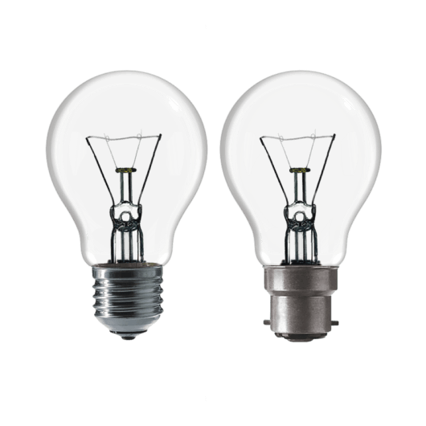



INTRODUCTION TO CONTROL SYSTEMS
REAL TIME EXAMPLES OF SYSTEM:
CLASSROOM
BULB
LAMP
KITE

Slide 7
INTRODUCTION TO CONTROL SYSTEMS
BASIC DEFINITIONS
INPUT: The excitation applied to a control system from an external source in order to produce the output is called input.
OUTPUT : The actual response obtained from a system is called output.
INPUT
INPUT
OUTPUT

Slide 8
INTRODUCTION TO CONTROL SYSTEMS
BASIC DEFINITIONS
CONTROL: Control means to regulate, direct or command a system so that the desired objective is obtained.
CONTROL SYSTEM:
Now combine all terms
Control + System = Control System
INPUT
CONTROL
SYSTEM
OUTPUT

Slide 9
Do not edit How to change the design
Which of these is the best example of a system?
The Slido app must be installed on every computer you’re presenting from

Slide 10
INTRODUCTION TO CONTROL SYSTEMS
REFERENCE:
PROPER
OUTPUT
INPUT
SYSTEM
INPUT
CONTROL
SYSTEM
DESIREOUTPUT
CONTROL SYSTEM: A control system is a system in which the output quantity is controlled by varying the input quantity to obtained desired output.
https://www.slideshare.net/AmitNevase/control-system-63615804?qid=c8d0cf53-5c3f-4ee1-8f62-0267cd6cbd84&v=&b=&from_search=3

Slide 11
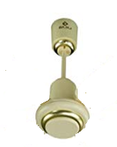
230 V / 50 Hz
AC Supply
INPUT
NO PROPER / DESIRED OUTPUT
NO AIR FLOW
Ceiling fan without blades cannot provide a proper / desired output, therefore this is not a system.
https://www.slideshare.net/AmitNevase/control-system-63615804?qid=c8d0cf53-5c3f-4ee1-8f62-0267cd6cbd84&v=&b=&from_search=3

Slide 12
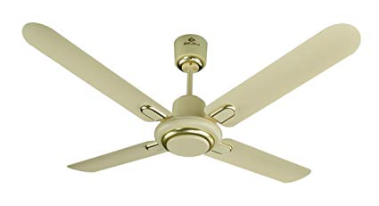
A fan with blades and without regulator (controlling element) is a system because it provides proper output i.e. airflow but it cannot be a control system.
230 V / 50 Hz
AC Supply
INPUT
AIR FLOW
PROPER
OUTPUT
SYSTEM
https://www.slideshare.net/AmitNevase/control-system-63615804?qid=c8d0cf53-5c3f-4ee1-8f62-0267cd6cbd84&v=&b=&from_search=3

Slide 13
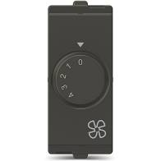
A ceiling fan with blades and regulator can be a control system because it provides the DESIRED OUTPUT i.e. controlled air flow.
230 V / 50 Hz
AC Supply
INPUT
CONTROLLED AIR FLOW
DESIRED
OUTPUT
CONTROL ELEMENT
(REGULATOR)
SYSTEM

Slide 14
Do not edit How to change the design
Which fan setup is a control system?
The Slido app must be installed on every computer you’re presenting from

Slide 15
REQUIREMENT OF A GOOD CONTROL SYSTEM:
Accuracy: Accuracy is high as any error arising should be corrected. Accuracy can be improved by using feedback element. To increase accuracy error detector should be present in control system.
Sensitivity: Control system should be insensitive to environmental changes, internal disturbances or any other parameters.
Noise: Noise is an undesirable input signal. Control system should be insensitive to such input signals.
Stability: In the absence of the inputs, the output should tend to zero as time increases. A good control system should be stable.

Slide 16
(v) Bandwidth: The range of operating frequency decides the bandwidth. For frequency response bandwidth should be large.
(vi) Speed: The speed of control system should be high.
(vii) Oscillations: For good control system, oscillation should be constant or sustained oscillation which follows the Barkhausein’s criteria.

Slide 17
CLASSIFICATION OF CONTROL SYSTEMS
Depending upon the purpose control system can be classified as follow (ref. Control systems by A. Anand Kumar)
Depending on hierarchy:
(i) Open loop control systems
(ii) Closed loop control systems
(iii) Adaptive control systems
(iv) Learning control systems
2. Depending on the presence of Human being as apart of the control system
(i) Manually control systems (ii) Automatic control systems

Slide 18
3. Depending on the presence of feedback
(i) Open loop control systems
(ii) Closed loop control systems or feedback control systems.
4. According to the main purpose of the system
Position control systems
Velocity control systems
Process control systems
Temperature control systems
Traffic control systems etc.

Slide 19
Feedback control systems may be classified as
linear control systems and nonlinear control systems.
Continuous data control systems and discrete data control systems , ac (modulated) control systems and dc (unmodulated) control systems.
Multi input multi output(MIMO) system and single input single output (SISO) systems.
Depending upon the number of poles of the transfer function at the origin, systems may be classified as Type-0, Type-1, Type-2 systems etc.

Slide 20
(v) Depending on the order of the differential equation, control systems may be classified as first order system, second order system etc.
(vi) According to type of damping control systems may be classified as Undamped control systems, damped control systems, Critically damped control systems and Overdamped control systems.

Slide 21
OPEN LOOP CONTROL SYSTEMS: Those systems in which the output has no effect on the control action, i.e. on the input are called open loop control systems. In any open loop control system, the output is not compared with reference input.
Block Diagram of an open loop system
Example of open loop system is washing machine-soaking, washing and rinsing in the washer operate on a time basis.
Reference Input
Controlled Variable (output)
Actuating signal
Controlled process (plant)
Controller

Slide 22
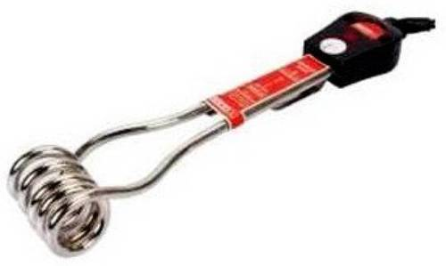
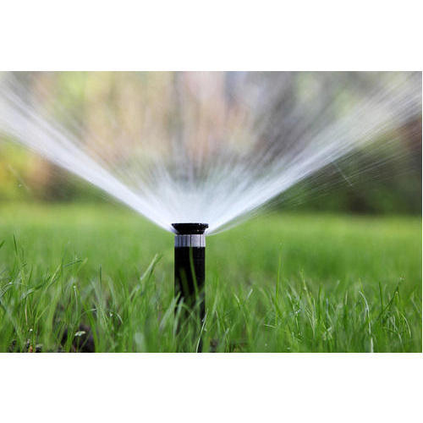

EXAMPLES OF OPEN LOOP SYSTEMS:
IMMERSION ROD
SPRANKLE
TRAFFIC LIGHT (СВЕТОФОР)

Slide 23
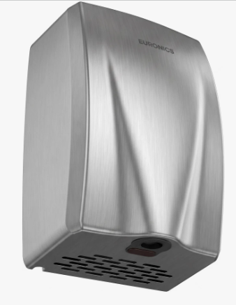
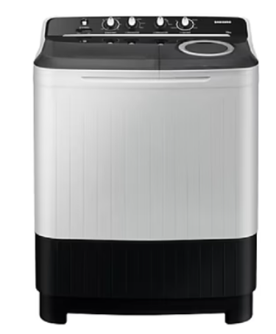
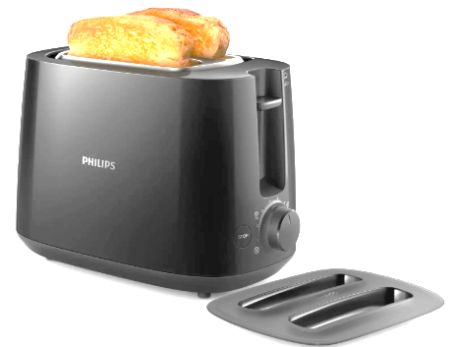
EXAMPLES OF OPEN LOOP SYSTEMS:
Electric Hand Drier
Hot air comes out as long as you keep your hand under the machine irrespective of how much your hand dried.
Washing Machine
Bread Toaster

Slide 24
CLOSED LOOP CONTROL SYSTEM: Closed loop control systems are also known as feedback control systems. A system that maintains a prescribed relationship between the output and reference input by comparing them and using the difference as a mean of control is called feedback control system.
Example of feedback control system is a room temperature control system. By measuring the room temperature and comparing it with the desired temperature, the thermostat turns the cooling or heating equipment on or off.

Slide 25
Block Diagram of a Closed Loop System
Actuating signal
Ref. Input
Error Signal
Output
+
Controller
Plant
-
Feedback
Signal
Feedback Path Element

Slide 26
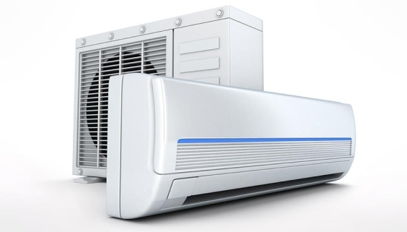

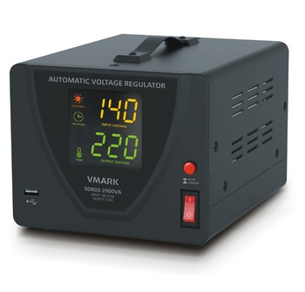
EXAMPLE OF CLOSED LOOP SYSTEM:
AIR CONDITION
AUTOMATIC VOLTAGE STABLIZER
AUTOMATIC ELECTRIC IRON

Slide 27

BLOCK DIAGRAM:
DESIRED TIME
ELECTRICAL ENERGY
DESIRED DRYNESS
TIMER
HEATING
ELEMENT
CLOTHES
INPUT
FEEDBACK
ELEMENT
(SENSOR)
OUTPUT
FEEDBACK LOOP
https://www.slideshare.net/AmitNevase/control-system-63615804?qid=c8d0cf53-5c3f-4ee1-8f62-0267cd6cbd84&v=&b=&from_search=3

Slide 28
Do not edit How to change the design
Open loop control systems are
The Slido app must be installed on every computer you’re presenting from

Slide 29
Do not edit How to change the design
Human being is also a system?
The Slido app must be installed on every computer you’re presenting from

Slide 30
Do not edit How to change the design
Major type of control system are
The Slido app must be installed on every computer you’re presenting from

Slide 31
OPEN LOOP SYSTEM v/s CLOSED LOOP SYSTEM
S.NO. | OPEN LOOP SYSTEM | CLOSED LOOP SYSTEM
1. | These are not reliable | These are reliable
2. | It is easier to build | It is difficult to build
3. | They Consume less power (in control circuit) | They Consume more power
4. | They are more stable | These are less stable
5. | Optimization is not possible | Optimization is possible

Slide 32
COMPONENTS OF CLOSED LOOP SYSTEMS
Command
Input
Ref. Input
Element
Controlled
Element
Controlled system
+
-
Feedback Element

Slide 33
Command: The command is the externally produced input and independent of the feedback.
Reference input element: This produces the standard signals proportional to the command.
Control element: This regulate the output according to the signal obtained from error detector.
Controlled System: This represents what we are controlling by the feedback loop.
Feedback Element: This element fed back the output to the error detector for comparison with the reference input.

Slide 34
EXAMPLE: The human eye has a biological control system that varies the pupil diameter to maintain constant light intensity to the retina. As the light intensity increases, the optical nerves send a signal to the brain, which commands internal eye muscles to decrease the pupil’s eye diameter. When the light intensity decreases, the pupil diameter increases.
Draw a block diagram of the light-pupil system indicating the input, output.
Reference: NISE’s Control Systems Engineering, Dr. Rajeev Gupta, Wiley India Pvt. Ltd., New Delhi, Edition 2011

Slide 35
SOLUTION:
NERVOUS SYSTEM ELECTRICAL IMPULSES
DESIRED
LIGHT INTNSITY
INTERNAL EYE MUSCLES
BRAIN
RETINA’S LIGHT INTENSITY
RETINA + OPTICAL NERVES

Slide 36
Do not edit How to change the design
Rate this lecture
The Slido app must be installed on every computer you’re presenting from

Slide 38
THANK YOU VERY MUCH

